Slide 1
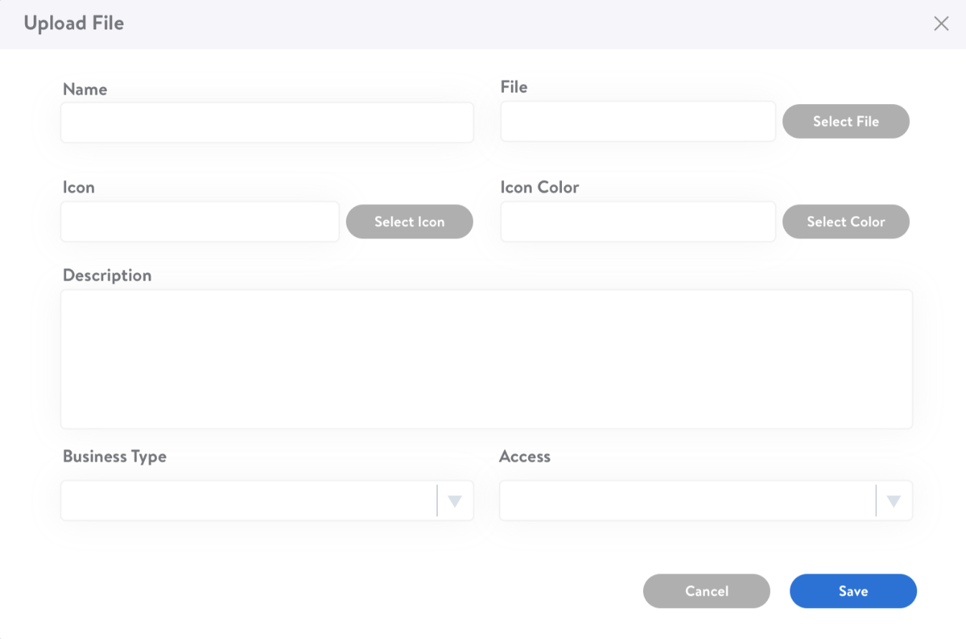
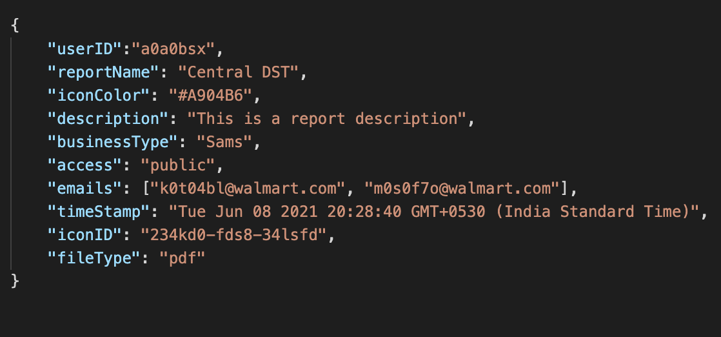
+
Report (PDF/Excel/PPT)

Slide 2



RDBMS

Slide 3
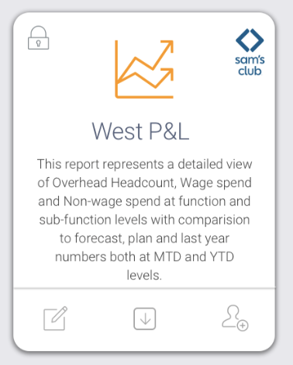

Slide 4
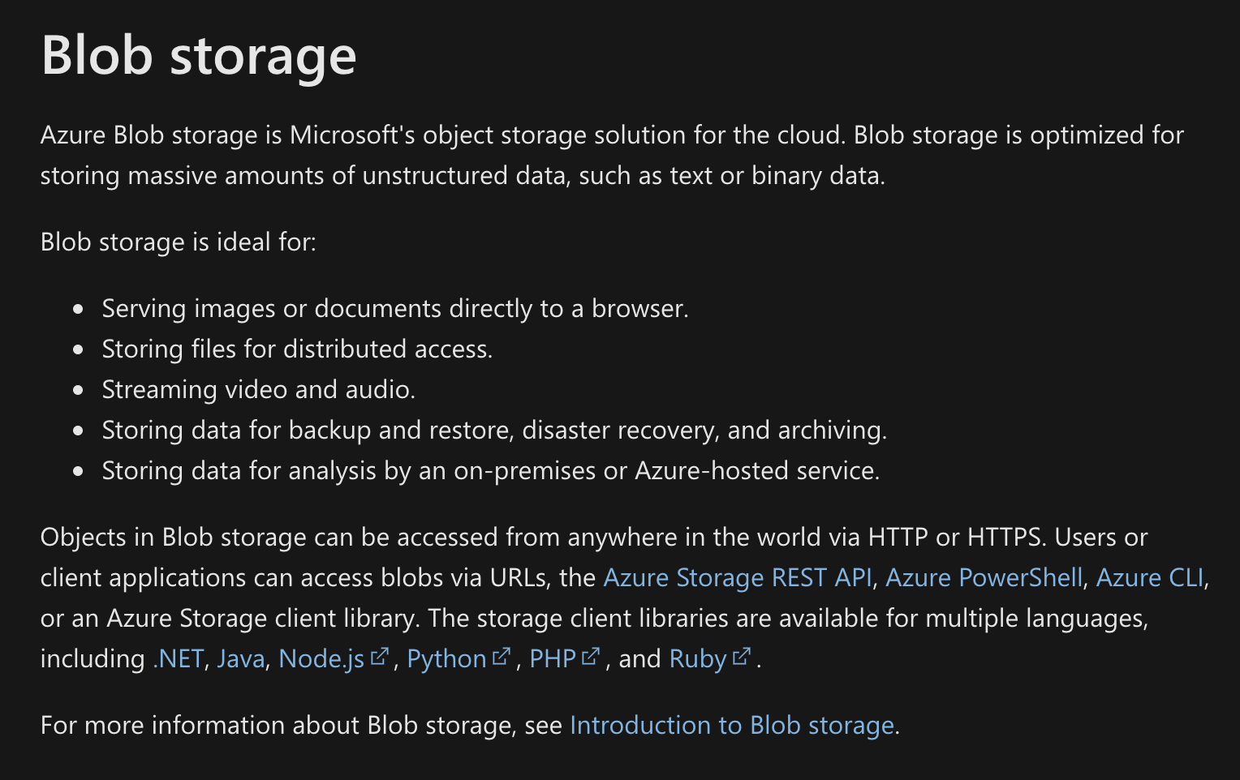
APIs
getReportsByUser: Will Fetch the Recent Reports Uploaded by the User
getIconsList: Will fetch list of icons to select from
getReportNameSuggetions: Will Fetch list of Suggestion Based on the input
getReportByName: Will Fetch a Report/s By Name
uploadReport: Will be used to upload report
getBusinessTypes: Will Fetch list of Business Types
getAccessTypes: Will Fetch list of access Types
getReportIconMapping: Will get ReportIcon mapping
getReportsByPeers: Will Fetch the Recent Report Uploaded By Others on Which the User has access
getPopularReports: Will Fetch the Popular Reports Based on number of Downloads
getEmailSuggetions: Will Fetch list of Email for Suggestion Based on input
updateReport: Will be used to update Report Details
Blob Storage Overview
Azure Storage Account Creation

Slide 5
Icons
Icons will be predefined, or It will be uploaded by Users, or It can be Both?
-If Icons are uploaded by users, do we have a defined limit for
its dimensions and format?
If you see the journey icons will be selected by the user during the naming process. However, if the user does not select any icon the system should by default put any random icon. Also, if an icon has been used next time the same icon can be used but that color should not be available.
In order to pick colors to the icons, the only compatible format to do that would be SVG, the user cannot upload a JPG or PNG icon and then change its color… or as you said @Ritesh Gupta if the icon is already taken, force to pick another color, that’s not possible with bit map icons like JPG or PNG
Therefore, the only option is SVG, but average users don’t even know the SVG format exists… so we cannot expect them to upload such type of icons…
Then I think the solution is to provide them an icons catalog to choose from, that way the functionality can validate if the icons is taken or not, to select from colors and disabled those colors already used with that particular icon…
File Size Limit
What will be the max limit for the Report File Size and for the Icon Size? What is the File Size Range? Could you please provide
some sample reports as well?
There is no limit to file size. Since the user will be uploading and we cannot restrict them on size. Reason being we want all
reports to reside there, and I am not sure if the user will be able to reduce the file size on their own

Slide 6
File Formats
For now, we are uploading only PDF. Will it be permanent? Or is there any chance to have multiple file format for reports,
like PDF, PPT or Excel soon?
User should be able to upload pdf, excel and ppt
Encryption
Do We need to encrypt the data before Storing it? How much sensitive our Data is?
If that’s a good practice will advise we should encrypt. Data is sensitive.
Report Name Uniqueness
Report Name will be unique throughout the App? Or Report Name will be unique per User? Or It can be Duplicated?
Report name need not be unique, but the only restriction is the icon would change either in color or design and system should
give a popup on informing the user that this name exists, do you want to continue. For icon it will not allow user to use same
icon with colors already used.
Ambika: Report Name should be unique based on Business Type & Access Type

Slide 7
Notification After uploading the report, App needs to Notify the Users via email

